Slide 1

Product Management Office Hrs– Module 3 with Raunak Goyal Oct 22, 2023

Slide 2
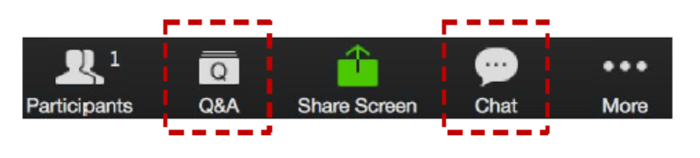
Zoom Chat and Q&A Box
Please type your questions in the Q&A box
Also, ongoing discussion in the Chat
Please enter your questions in the Q&A box. We’ll answer these in the Q&A and stop from time to time to bring these to the broader attention of the class
Please enter your response in the ‘Chat box.’ Before you send it, please make sure that your response goes to ‘Everyone’
Notes:
Please enter your questions in the Q&A box. We’ll answer these in the Q&A and stop from time to time to bring these to the broader attention of the class.
Please enter your response in the ‘Chat box.’ Before you send it, please make sure that your response goes to ‘Everyone’
We will continue to try to make the sessions interactive. Raise your hand if you’d like to talk and we will unmute you. For questions that we can not answer interactively we will take offline and post them in the discussion groups.
Now for today’s agenda

Slide 3



AGENDA
Getting Help
Module Review
Assignment Discussions
Additional Resources
Programme Schedule
Next Week
Q&A
Notes:
In today’s session we will cover the following topics:
Getting Help
Module Review
Assignment Discussions
Additional Resources
Programme Schedule
Next Week
Q&A

Slide 4
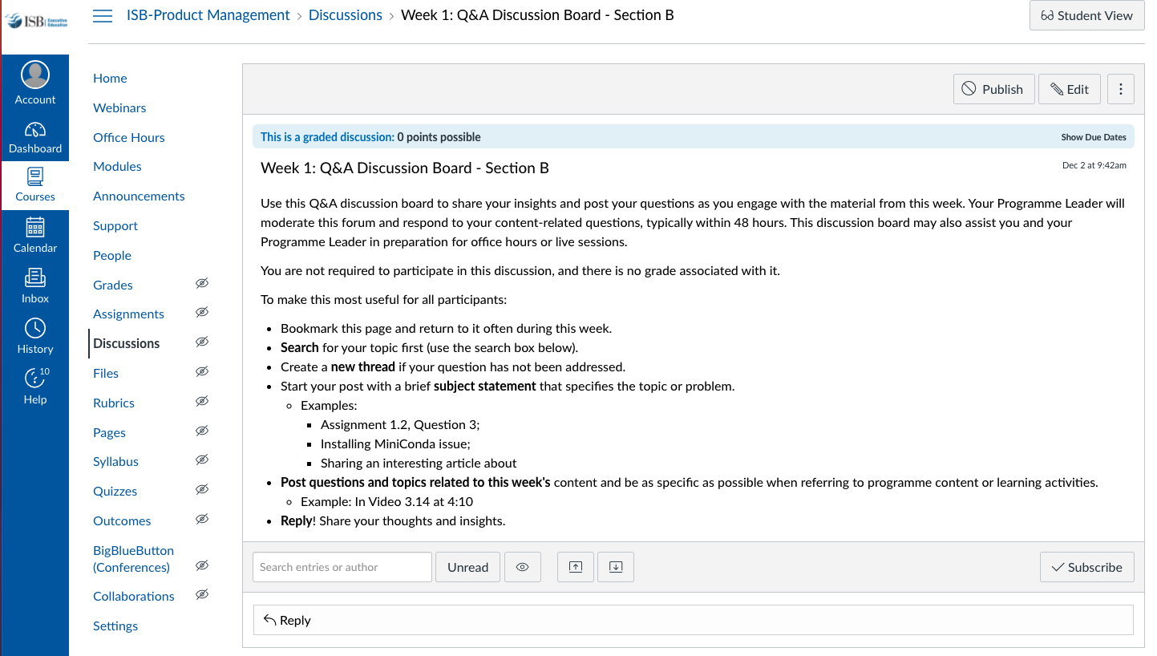
GETTING HELP
Notes:
One of the best resources are your classmates. A great way to learn from them is to engage on the weekly discussion topic. We want to broadly encourage collaboration, though without plagiarism. Share your thoughts, concepts, pluses and minuses though not your actual answers.
These are accessible in the weekly module, though I have highlighted the page where you will be taken.
It is great that many of you are setting up study groups via WhatsApp. We encourage that independent initiative and effort, while the programme leaders can not participate in those groups, we will engage in the group discussions on Canvas. What we will also do is provide some of the additional resources we reference in office hours in these discussions.

Slide 5
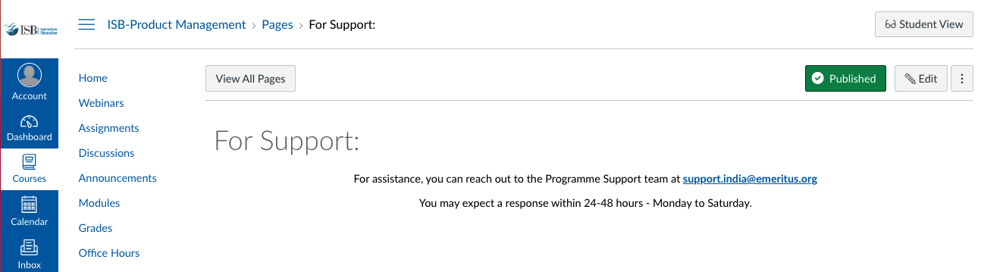
GETTING HELP
Notes:
And for content or assignment related material CLICK
You can reach out to your programme leader via an Inbox email for help. CLICK
Then for support for Canvas and other technical items contact support. This generally includes grading and associated scheduling and requests. When you click the Support tab it takes you to this page. Note that you are asked to send an email to programme.support@eruditus.com. For those of you who may not be in India, note the spelling of program.

Slide 6
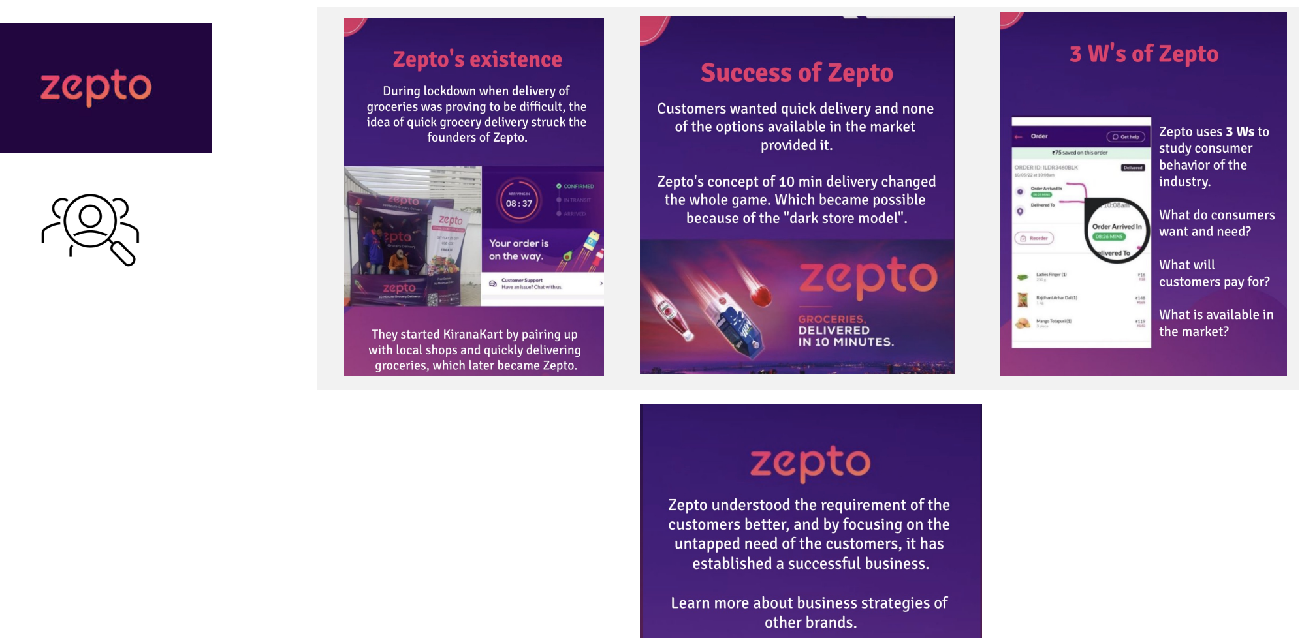
Product Market -Discovery

Slide 7
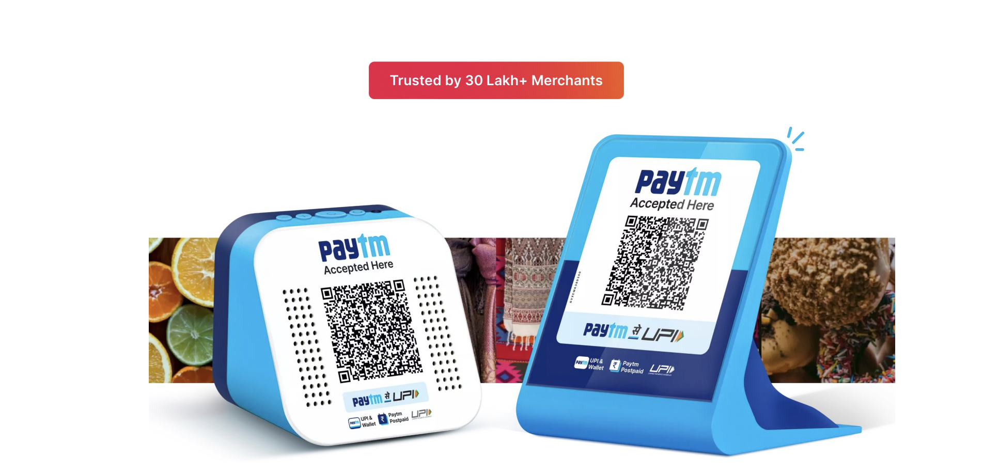
Product Market –Discovery (Contd)

Slide 8
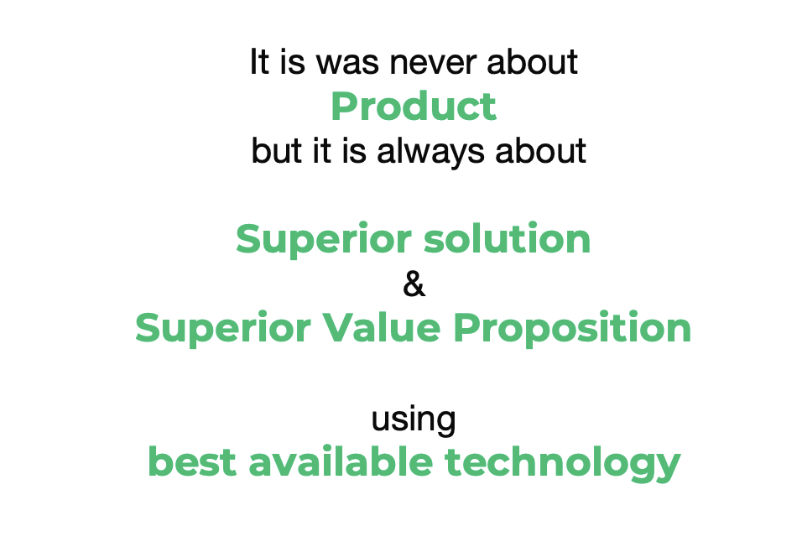
Product Market

Slide 9
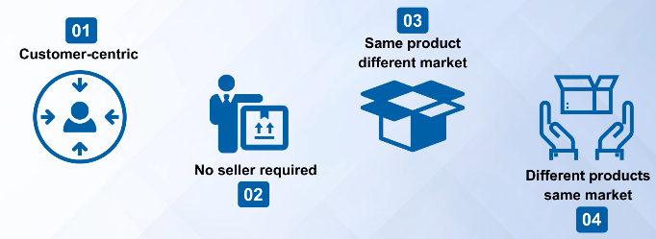
MODULE REVIEW – Kotler’s Definition of Product Market
Notes:
Philip Kotler provided a definition for new products and marketing. A market consists of all the potential customers sharing a particular need or want who might be willing and able to engage in exchange to satisfy that needor want.
Note the features of this definition, first, this definition puts customer need at the centre. Therefore, for any customer centric product development, we must use this definition. This definition is also at the heart of the popular Blue Ocean Strategy and helpful in finding new markets for targeting a new product. Second, there is no seller required for a market to exist. For example, some people may have a need for tourism to Mars, however, there is no seller offering such services to satisfy this need at this time. Third, under this definition, we can have the same product in different markets. For example, the same laptop can be sold to the consumer market as well as the business market. And fourth, under this definition, we can have different products in the same market.

Slide 10
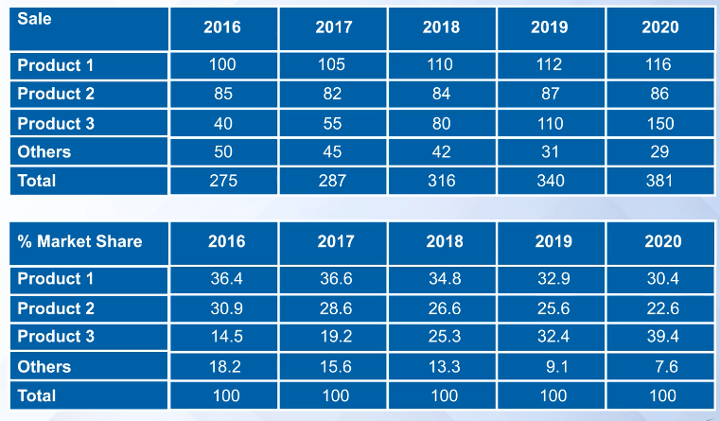
MODULE REVIEW – Market Definition & Consequences
Notes:
While.I won’t go through all the details, recall what professor Siddharth said in the second video about the market. He fleshed out both a positive and negative view of these numbers with only one change, the definition of the market. Recall how he said NO ONE tells you which market you are in, you do. Taking it a step further, it is often the customer.
Note how he focused a bit on defining a new product which could also produce a new market. Note how in his house the X-box game station was replaces with a PCs. Technology can help drive these changes and you need to be aware of the implications and applications of newer technology.

Slide 11
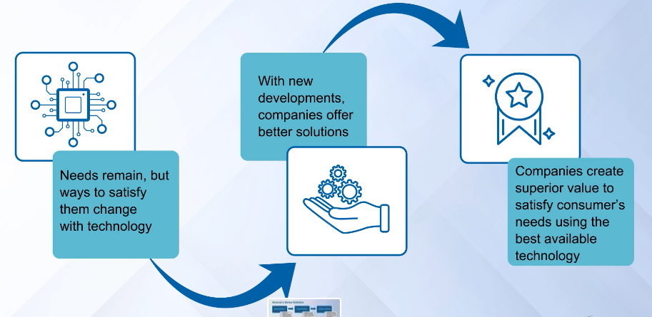
MODULE REVIEW – Market Definition & Consequences
Notes:
He focused a bit on defining a new product which could also produce a new market. In his house the X-box game station was replaces with PCs. Technology can help drive these changes and you need to be aware of the implications and applications of newer technology.
It is never about products, it is always about a superior solution or superior value proposition using the best available technology.
(Small disk drive example with Apple building an iPod)

Slide 12
MODULE REVIEW – MARKET SEGMENTATION
As per Philip Kotler, Market segmentation is a process of identifying groups of buyers with different desires or requirements

Slide 13
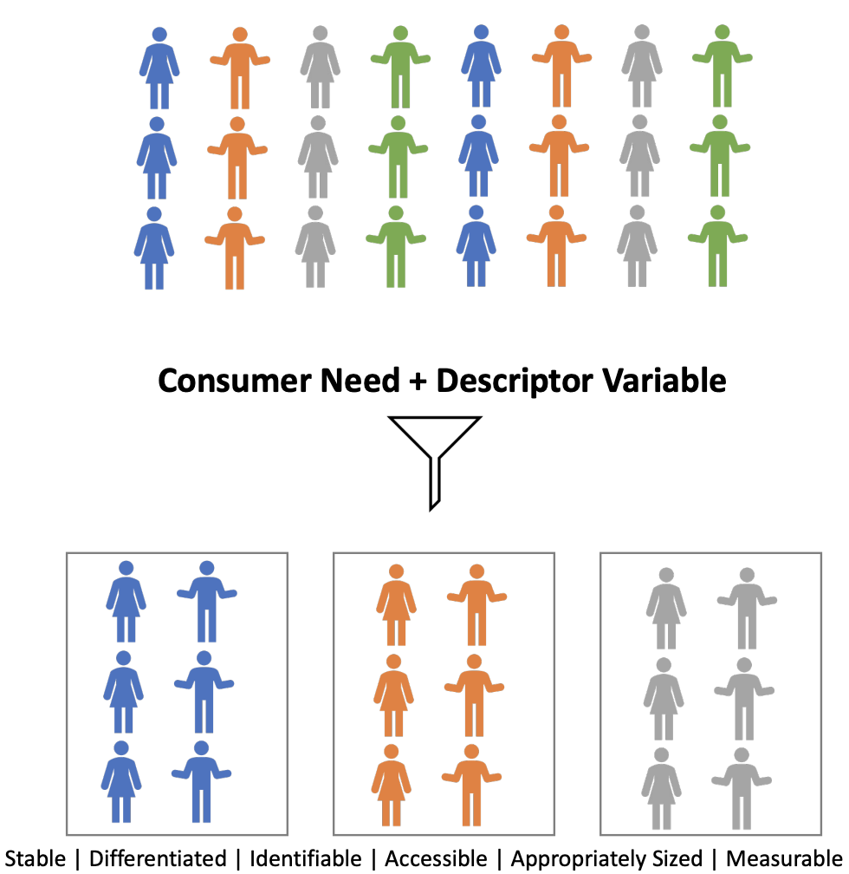
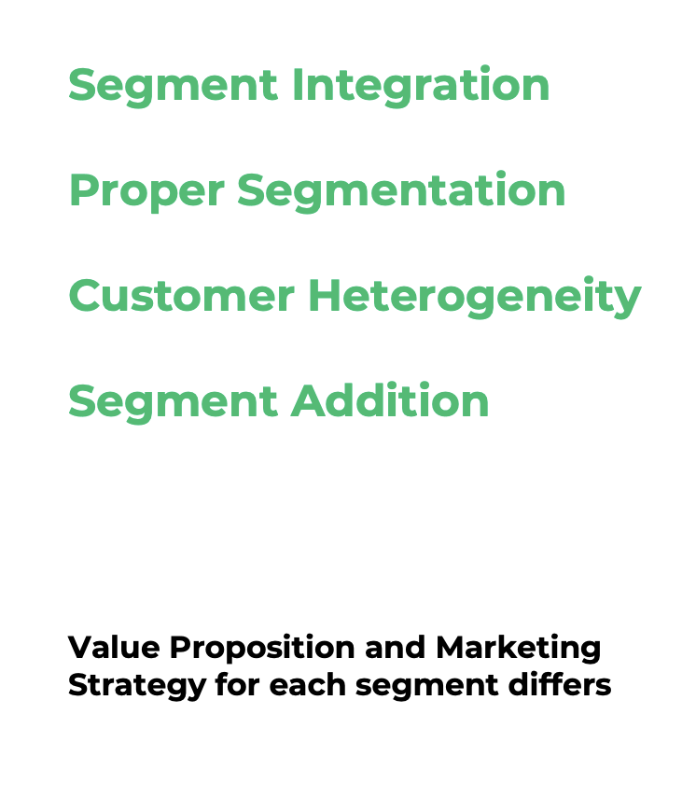
Segmentation

Slide 14
Why MARKET SEGMENTATION?
Better ROI
Better Conversion rate
Customer Retention
Expanding Efforts

Slide 15
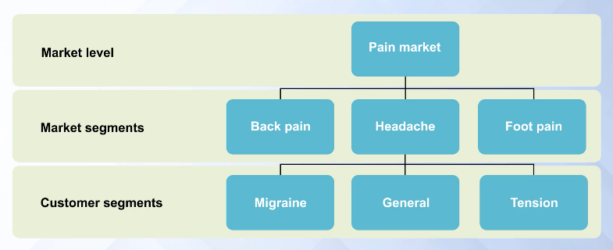
MODULE REVIEW – MARKET SEGMENTATION
Notes:
How do we define these solutions? Recall how professor Siddharth provided the segmentation of the market for pain and then further segmented the market.

Slide 16
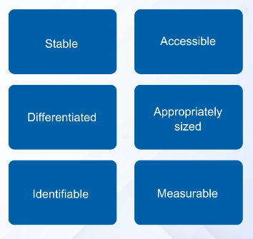
MODULE REVIEW – MARKET SEGMENTATION
Notes:
Fundamentally market segmentation requires these 6 features:
Stable
Accessible
Differentiated
Appropriately sized
Identifiable
Measurable

Slide 17
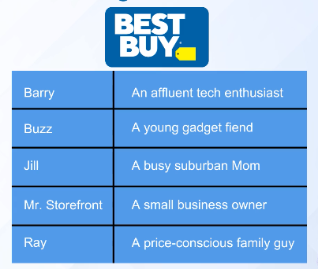
MODULE REVIEW – MARKET SEGMENTATION
Notes:
He then provided an alternative example of Best Buy that needs to appeal to many different consumers. Note each of the names on the left has a brief description, An affluent tech enthusiast, A young gadget fiend, A busy suburban mom, A small business owner and A price-conscious family guy.
These are all personas and are meant to address how each consumer may be looking for a different solution. Or stated a different way, the product may appeal to each consumer differently based upon how it solves their problem. The challenge with segmentation is that it can be costly. While creating a mass market product is desirable due to efficiencies it can leave you open to a competitor that differentiates their product to appeal to a certain segment.
The extreme version of segmentation is customer solutions for each customer. Professor Siddharth provides the example of the Apple iPhone as a custom solution since each person has their own set of applications on their phone. This customization can help create a bit of a lock-in for a customer making it harder for competitors to provide them their solution.
Professor Siddharth provides a number of great lectures on how to do segmentation, its importance, how and when to combine segments and a few other factors. As you search for the right answer note that it can be quite hard due to changing technology and market dynamics.

Slide 18
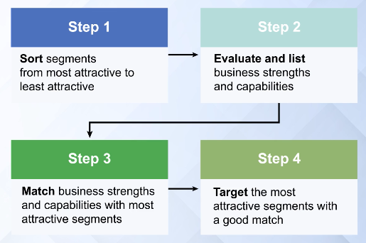
MODULE REVIEW – MARKET SEGMENTATION FACTORS
Notes:
Professor Siddharth provided a 3 step process to help determine which segments to target.
the first step, list factors that make a segment attractive to you. Note that these factors remain the same for all the segments you are considering.
the second step, the company considers the business strength needed by a company to win in each segment.
the third step, sort the segments from most attractive to least attractive.

Slide 19
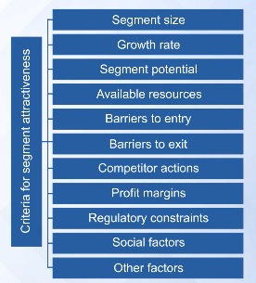
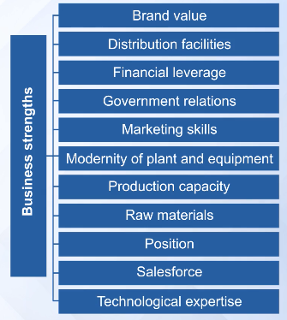
MODULE REVIEW – MARKET SEGMENTATION FACTORS
Notes:
And he provided a some of the factors for step 1 and 2 of the process.
The Criteria for segment attractiveness and
The business strengths of your company.

Slide 20
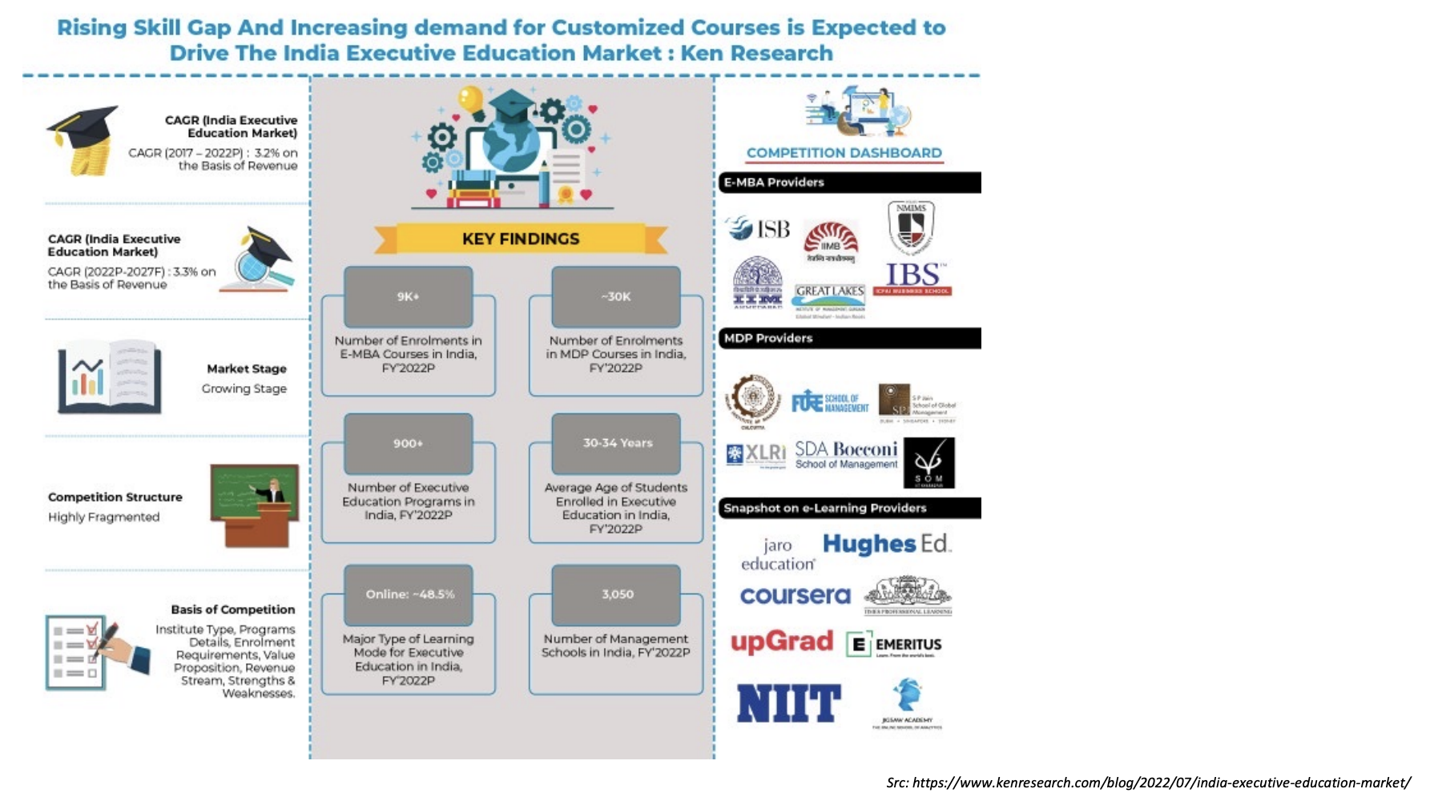
Understanding Market Structure & Opportunity

Slide 21
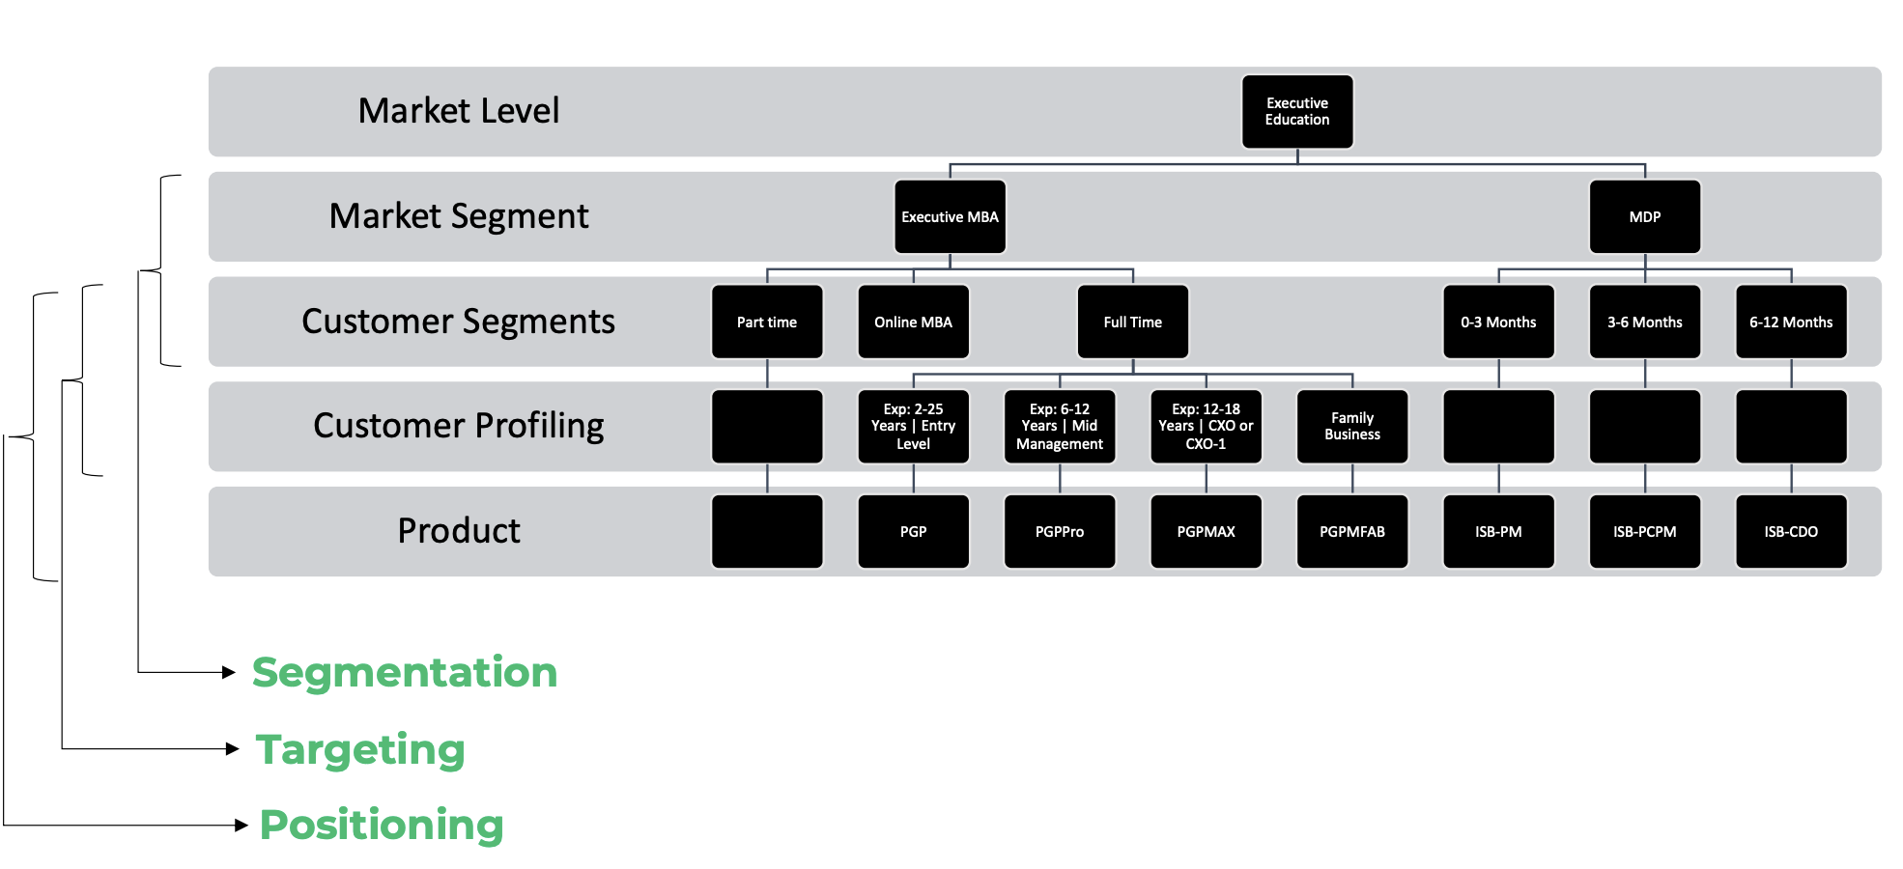
Understanding Market Structure & Opportunity

Slide 22
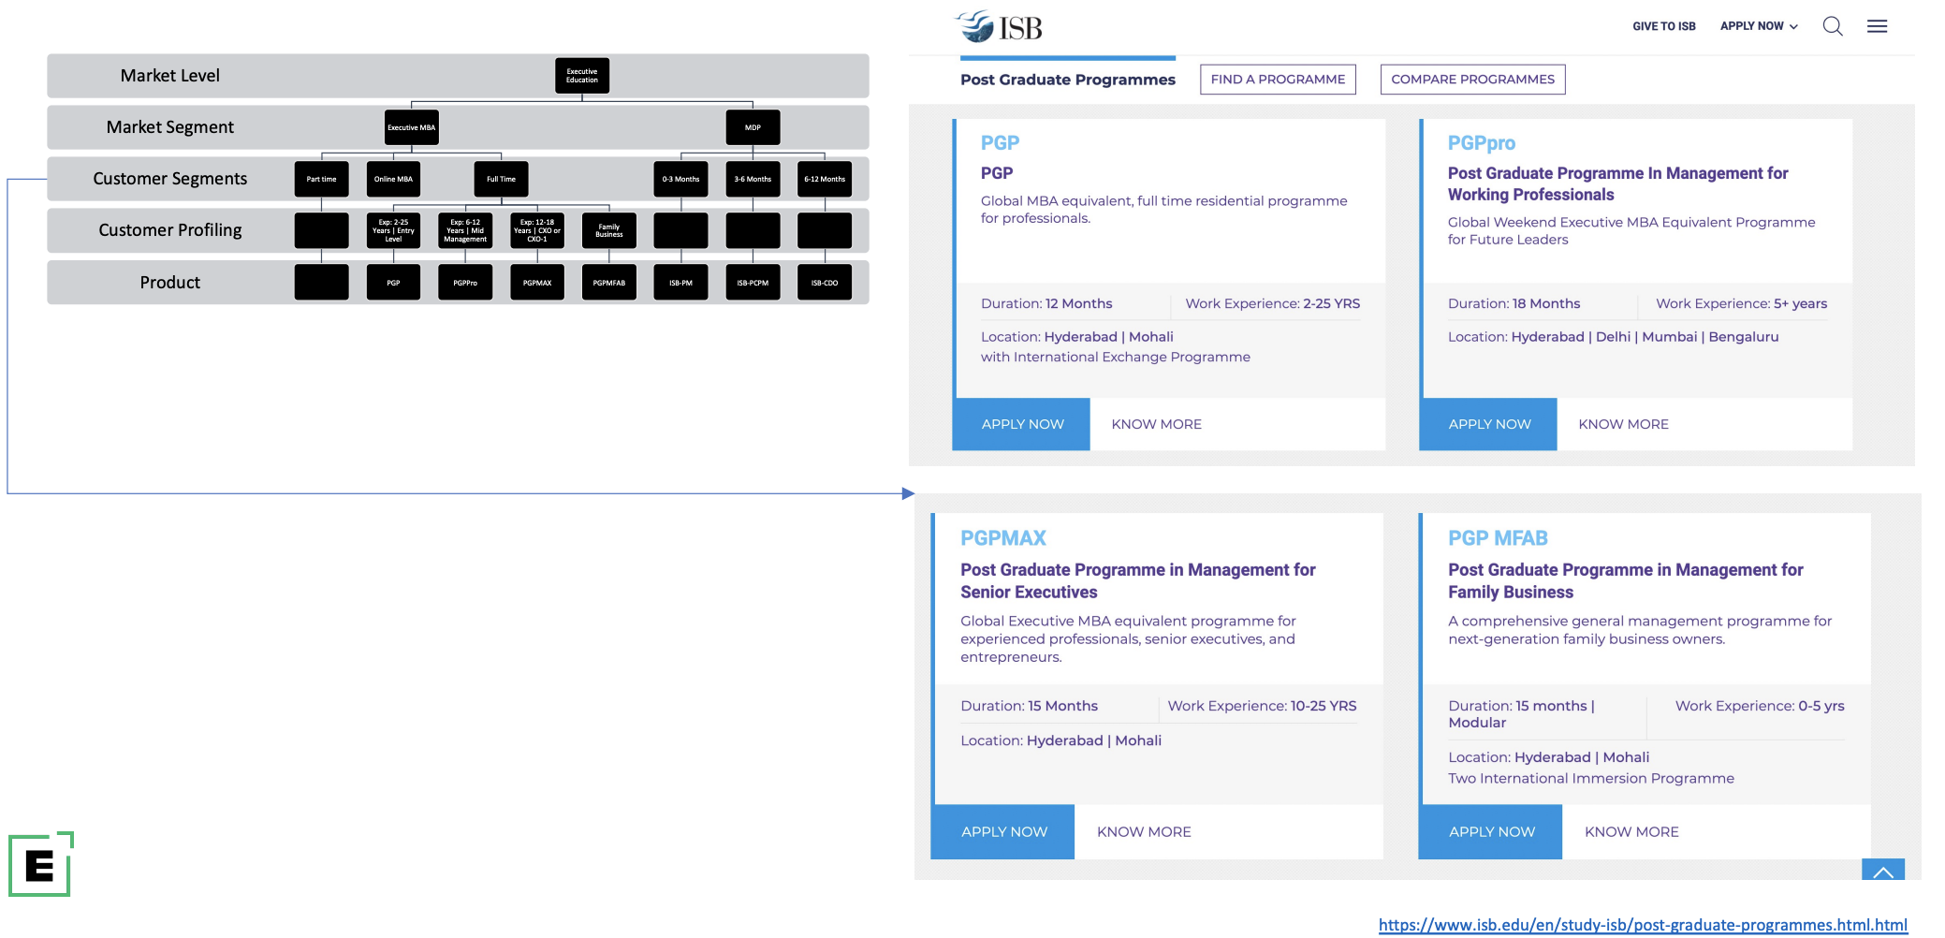
Segmentation – Executive MBA from ISB

Slide 23
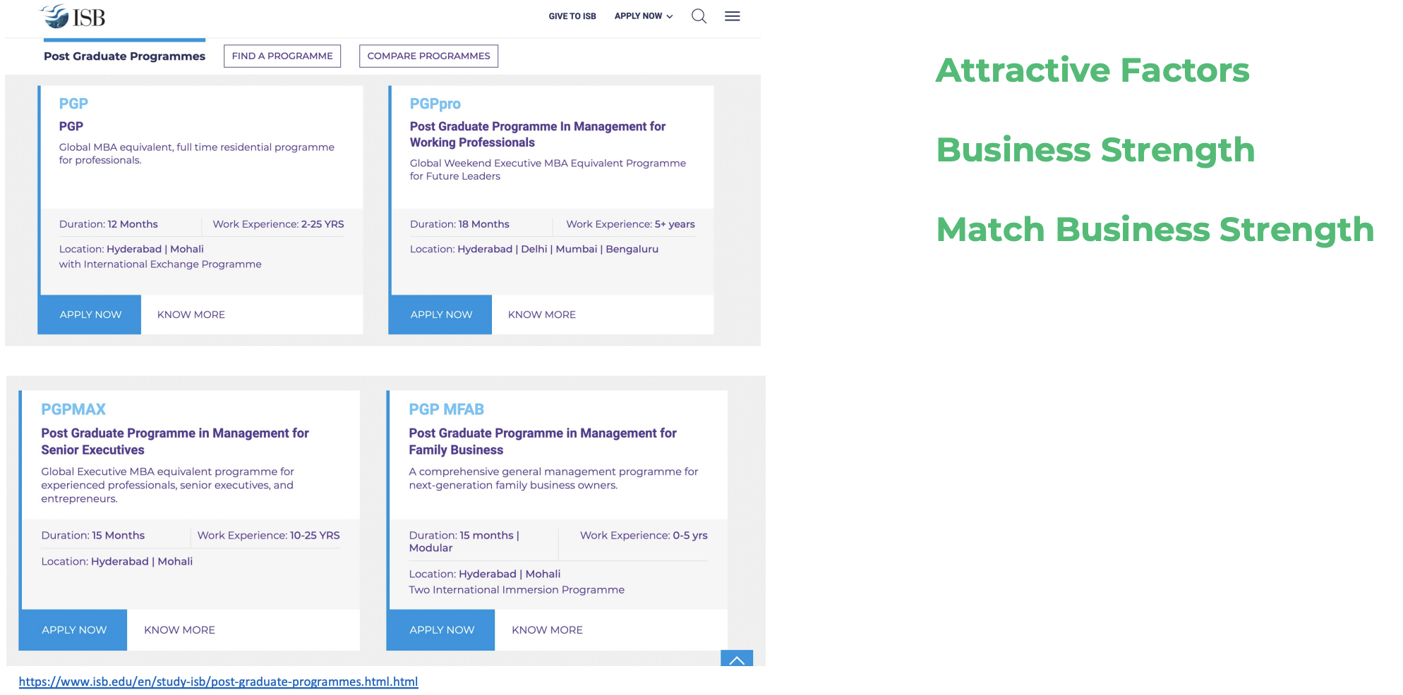
Targeting

Slide 24


Positioning-Targeted Customers

Slide 25
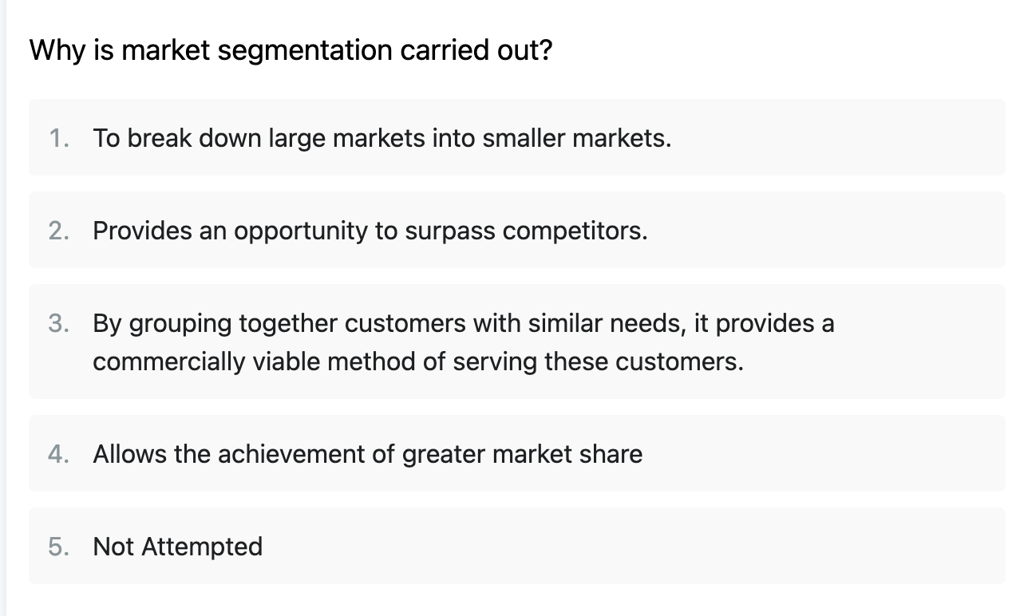
Market Segmentation Quiz 1

Slide 26
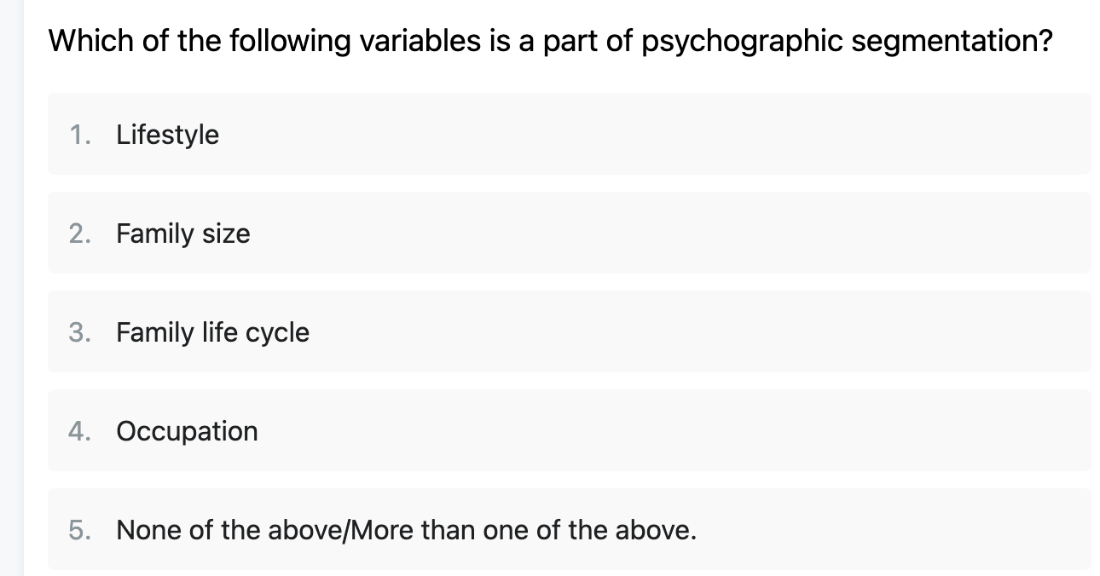
Market Segmentation Quiz 2

Slide 27
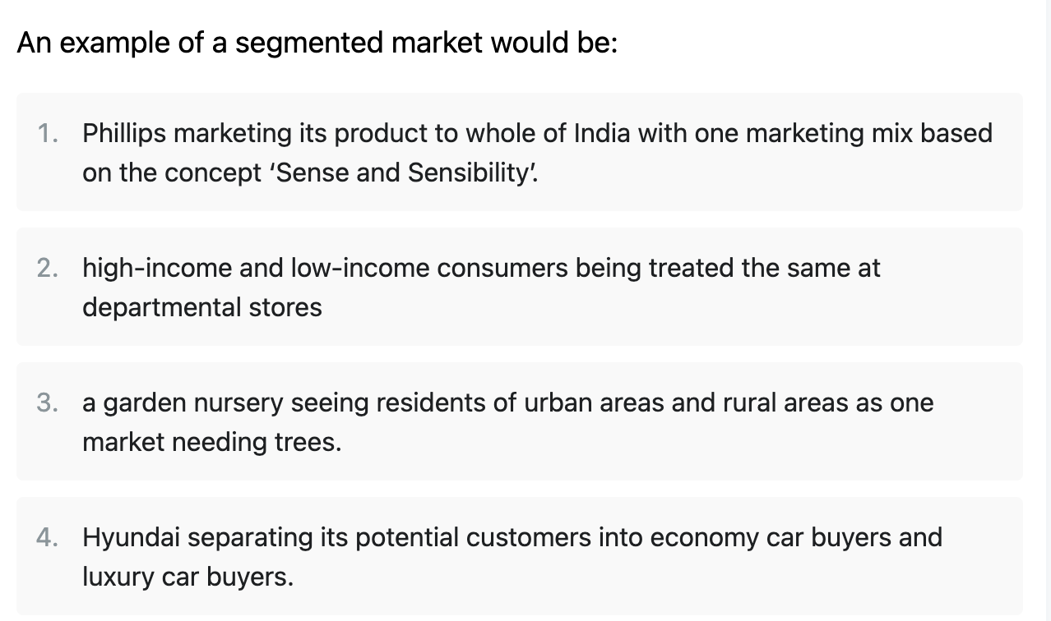
Market Segmentation Quiz 3

Slide 28
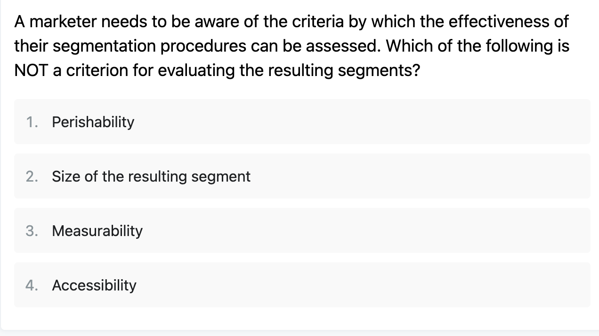
Market Segmentation Quiz 4

Slide 29
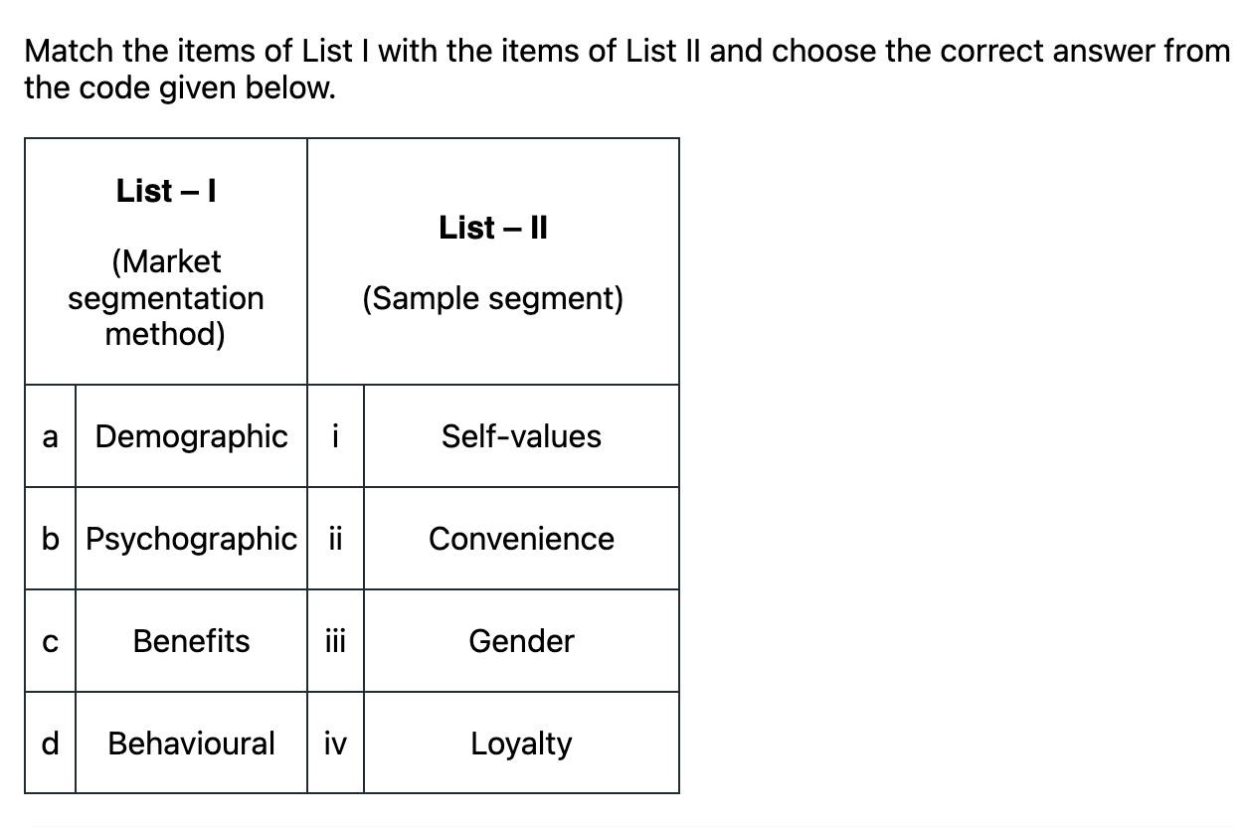
Market Segmentation Quiz 5

Slide 30
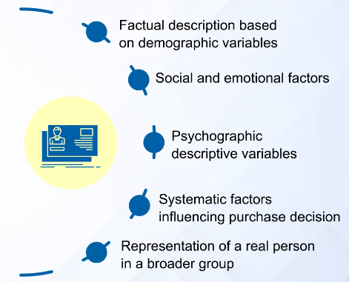
MODULE REVIEW – CUSTOMER PERSONA
Notes:
The question is how do you get to a particular segment? A way used by many companies is to develop Customer Personas for each segment. The primary rationale for this is that the focus is on the user and their required solution instead of the technology and product. Here are some of the factors that would go into a persona.

Slide 31
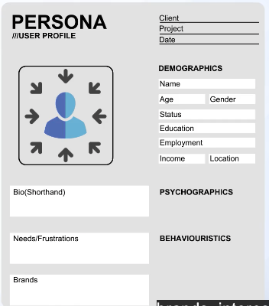
MODULE REVIEW – CUSTOMER PERSONA
Notes:
From these factors you define a persona based upon their characteristics. Here is the example professor Sidharth provided in the lectures. It includes:
Short biography
Needs and Frustration
Brands that the personal like
Demographic information like Name, Age, Gender, Status, Education, Employment, Income and Locaton
You may also want to define Psychographics and Bahaviors.
Now, with the background on personas let’s take a look at this week’s assignment

Slide 32
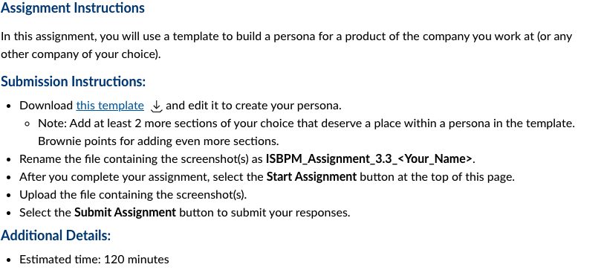
ASSIGNMENT 3.3 PROBLEM
Notes:
Assignment Instructions
In this assignment, you will use a template to build a persona for a product of the company you work at (or any other company of your choice).
Submission Instructions:
Download this template Download this templateand edit it to create your persona.
Note: Add at least 2 more sections of your choice that deserve a place within a persona in the template. Brownie points for adding even more sections.
Rename the file containing the screenshot(s) as ISBPM_Assignment_3.3_<Your_Name>.
After you complete your assignment, select the Start Assignment button at the top of this page.
Upload the file containing the screenshot(s).
Select the Submit Assignment button to submit your responses.
Additional Details:
Estimated time: 120 minutes

Slide 33
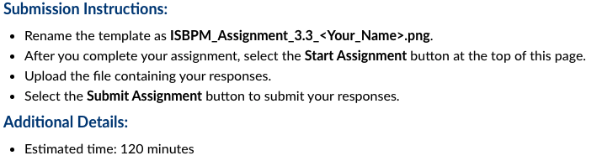
ASSIGNMENT 3.3 SUBMISSION
Notes:
To help you get used to the assignments, let’s focus for a moment on the submission instructions:
CLICK
Submission Instructions:
Rename the template as ISBPM_Assignment_3.3_<Your_Name>.png.
After you complete your assignment, select the Start Assignment button at the top of this page.
Upload the file containing your responses.
Select the Submit Assignment button to submit your responses.
CLICK
Additional Details:
Estimated time: 120 minutes
CLICK
The suggested amount of time it should take you is about 90 minutes.
Now for the actual assignment.

Slide 34
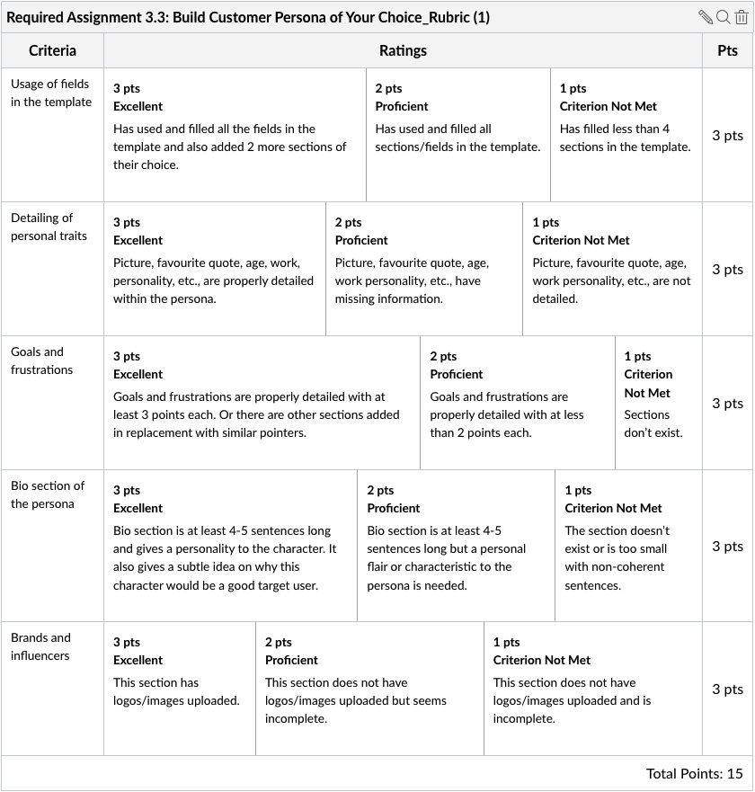
ASSIGNMENT 3.3 RUBRIC
Notes:
The document is looking for 5 things, each worth the same amount, 3 points each, for a total of 15 points.
We’ll use each of these as the topics for discussion

Slide 35
ASSIGNMENT DISCUSSION
Usage of fields in the template
Detailing of personal traits
Goals and frustrations
Bio section of the persona
Brands and influencers
Notes:
Usage of fields in the Xtensio template – this is pretty straightforward. The reference is to an earlier run of the course, use the template provided as a starting guideling. With that said, if you go to the Xtensio website you will see some nice templates for user persona. Note, some people call this the customer or buyer persona.
Detailing of personal traits – provide some details of their personality traits. For example, type A personality, etc.
Goals and frustrations – List some of their goals and frustrations. This is critical since the product will need to address the goals and frustrations in some way. Or, if the product doesn’t, then it may not be the right persona to target.
Bio section of the persona – Provide a bit of biographical information of the persona
Brands and influencers – What are some of the brands and influences of the persona, i.e. they like Adidas, BMW and Apple. They like to read the Wall Street Journal and follow Peter Theil on twitter.
For the brownie points, what else could you add beyond these items? ASK THE CLASS TO RESPOND
Watering holes, trade shows they attend, etc.
Should I add an additional slide as an example????
Here is the template . . .

Slide 36
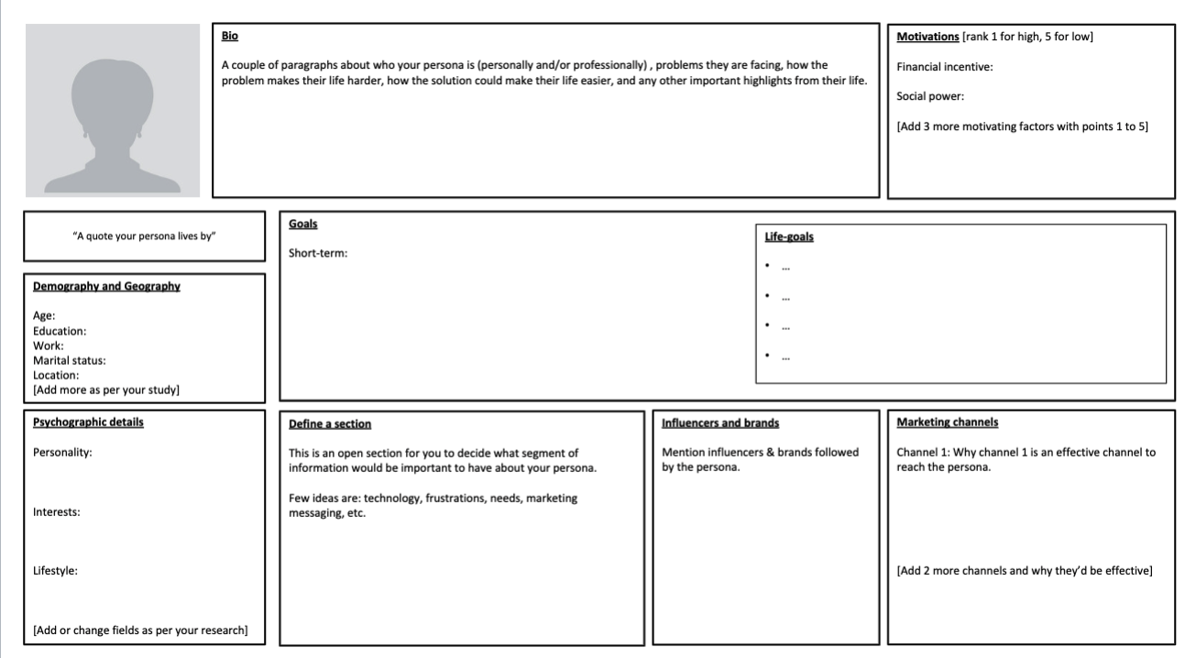
MODULE REVIEW – Buyer/User/Customer Persona
Notes:
This is a Powerpoint slide with the fields available to be completed. These are:
Photo
Bio
Motivations
Quote
Goals
Life Goals
Demography and Geography
Psychographic Details
Influencers/Brands
Marketing Channels.
Note that there is a box that says “Define a Section”. That is for you to add a couple of sections to the persona. Where you can make it graphical.
Note how the first item in the Rubric asks that you add 2 sections to the template.
The brands and influencer rubric is looking for logos.

Slide 37
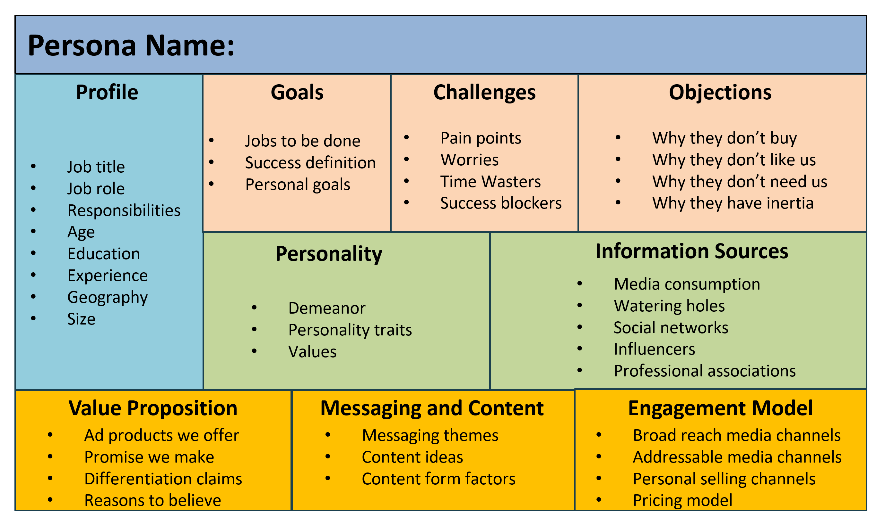
MODULE REVIEW – Buyer/User/Customer Persona
Notes:
Now that we have completed the discussion let me provide an example User Persona I like. If you search through the Xtensio templates, you may not find this exact one though you will see many of its components. This one has many sections, though as we saw in the lectures the real objective is to learn more about your target. This one has the following sections:
Persona Name – I suggest you give the persona a real name and even a picture. It is important that you learn to speak of the customer in their voice. These personas have many different components that you need to appeal to, or even avenues to reach them. Let’s walk through a few:
Goals
Challenges
Objections
Personality
Information Sources – You will see some extensions to the template that use this term and others.
Value Proposition
Messaging and Content
Engagement Model
And

Slide 38
PERSONA NAME: Bill the Coach CTO
Profile
Job title: IT Director
Job Role: overseeing technical operations, technology systems, IT Team
Responsibilities: maintaining operations and systems, eliminating security risks, manage IT team, increase user satisfaction, etc.
Age: 45
Education: Degree in Computer Science
Experience: 5 years as Director, 10 years as IT manager
Geography: United States
Size: 1000+ employees
Goals
Jobs to be Done – collaborate with local and remote teams; improve communications among mobile workforce
Success definition – improve team collaboration, meetings and productivity
Personal goals – bring more unity, creativity and cohesion to team meetings
Challenges
Pain points – lack of team spirit, team feels disjointed because some members are remote; collaboration is episodic, not sustained
Worries – team is not united, effective or decisive; poor communications;
Time Wasters - team conflicts, lack of participation, tech fails
Objections
Why they don’t buy – too expensive; value prop is unclear;
Why they don’t like us – previous version didn’t work well
Why they don’t need us – there are other collaboration solutions in the market
Why they have inertia – doesn’t have the budget; higher-ups prefer another product or do not believe Surface Hub 2 can deliver on promises
Personality
Demeanor – pleasant, confident and has a positive, professional attitude
Personality traits – sociable, energetic, decisive, a good speaker
Values – hard work, integrity, and discipline
Information Sources
Media consumption – books and magazines about technology and science; LinkedIn
Watering holes – tech meet ups;
Social networks - Twitter, Facebook,
Influencers – C-Suite, IT publications and blogs, customers
Professional associations – Assn of Information Technology Professionals (AITP)
Value Proposition
Promises we make – lighter, sleeker, easier to use, easy to install
Differentiation - more intuitive, design aesthetics, technical specs, ease of use to connect and create
Reasons to believe – intuitive experience, seamless integration of hardware and software, designed for maximum collaboration, improved speaker, sound, camera and video calling
Messaging and Content
Messaging themes – collaboration, teamwork, co-creation, productivity
Content ideas – brainstorm with others, engaging and productive meetings, connect with teammates across the world.
Content form factors – website, blog, video, images
Engagement Model
Broad reach media channels – TV and print advertising, audio/radio advertising, digital advertising
Addressable media channels – Email marketing, social media marketing, search engine marketing, mobile devices, direct mail
Personal selling channels – face-to-face selling in person by the sales force to existing and prospective customers
Pricing model – unknown but believed to be comparable with Google’s Jamboard and Cisco’s Spark Board($5,000)
Notes:
Here is an example persona completed. Ideally it would have a nice picture so you can think of this person when you and the broader product team are talking about them. Let’s walk through this mythical persona in a bit more detail
Profile
Goals
Challenges
Objections
Personality
Information Sources
Value Proposition
Messaging and Content
Engagement Model

Slide 39
QUESTIONS FROM DISCUSSION BOARDS & IN-BOX
The examples that professor shared are mostly for the B2C market. I want to understand what value will the person's interests or political views add to the entire marketing activity. It would be great if someone could please share some examples of user personas in B2B market. From my understanding it is the company profile that should matter. So should I focus on developing the company persona rather than user persona?
Are personas different for B2B markets?
Notes:
The examples that professor shared are mostly for the B2C market. I want to understand what value will the person's interests or political views add to the entire marketing activity. It would be great if someone could please share some examples of user personas in B2B market. From my understanding it is the company profile that should matter. So should I focus on developing the company persona rather than user persona?
I have modified this question and simplified it a bit
Are personas different for B2B markets?
More on that in the additional resources section.

Slide 40
QUESTIONS FROM DISCUSSION BOARDS & IN-BOX
What is the different between Product Management Project Management?
A product can be understood as a system (a good, service, platform, application, etc.) that is designed and maintained to solve both customer and business problems to achieve more value. A product does not have a defined end date and is constantly being adapted to suit the market’s needs.
A product management team is more long-term and stable than project teams as they have continual activities that require longevity and cohesion. Product managers play a more strategic role in the prioritization of initiatives that ensure strategic market value and success. Product managers are in charge of getting market success.
A project as a temporary arrangement with a ‘defined beginning and end in time, and therefore defined scope and resources. A project is typically set up to create a product or service and the team is typically disbanded at the completion of the project.
The job of a project manager is to oversee predefined projects, thus having a smaller input into the definition and prioritization of goals and projects. A project manager can be seen as the person who executes product development.
Notes:
What is the different between Product Management Project Management
A product can be understood as a system (a good, service, platform, application, etc.) that is designed and maintained to solve both customer and business problems to achieve more value. A product does not have a defined end date and is constantly being adapted to suit the market’s needs.
A product management team is more long-term and stable than project teams as they have continual activities that require longevity and cohesion. Product managers play a more strategic role in the prioritization of initiatives that ensure strategic market value and success. Product managers are in charge of getting market success.
A project as a temporary arrangement with a ‘defined beginning and end in time, and therefore defined scope and resources. A project is typically set up to create a product or service and the team is typically disbanded at the completion of the project.
The job of a project manager is to oversee predefined projects, thus having a smaller input into the definition and prioritization of goals and projects. A project manager can be seen as the person who executes product development.

Slide 41
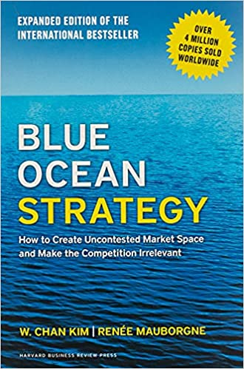
ADDITIONAL RESOURCES
Notes:
In our last office hours session, some of you asked for additional resources. CLICK
Let me start with a book mentioned by professor Siddharth, Blue Ocean Strategy by W Chan Kim. In it, it argues that cutthroat competition results in nothing but a bloody red ocean of rivals fighting over a shrinking profit pool. Based on a study of 150 strategic moves (spanning more than 100 years across 30 industries), the authors argue that lasting success comes not from battling competitors but from creating “blue oceans”—untapped new market spaces ripe for growth.
https://amzn.to/3pOvdrN

Slide 42
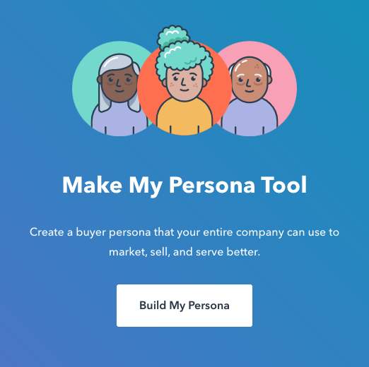
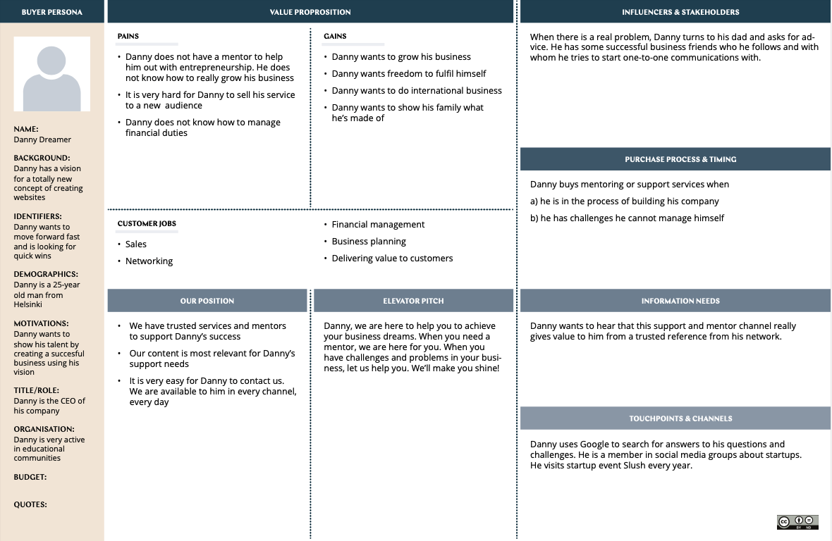
ADDITIONAL RESOURCES
Notes:
If you do an internet search for buyers' persona you will come across a number of templates, here are a couple I like. CLICK
The Columbia Road version that you can get from their website.
https://www.columbiaroad.com/canvas/download-buyer-persona-canvas
CLICK
And the Hubspot Buyer Persona Tool. It is an interactive website that build a persona for you. Though they also allow you to download the templates if you prefer
https://www.hubspot.com/make-my-persona

Slide 43
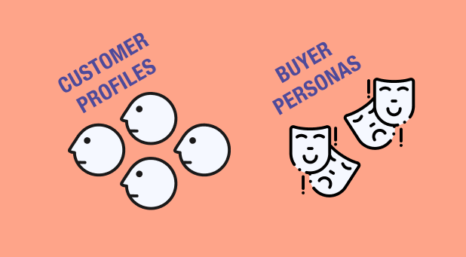
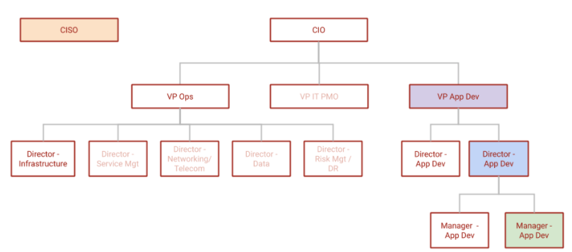
ADDITIONAL RESOURCES
Notes:
Selling to a Consumer is different than selling to a business. It is typically easier to define a buyer in the consumer space. In the business space you often need to target multiple personas. For example, you may be selling an expensive software system to a company. While the VP of Operations may have the authority to make the decision the company will often set up a committee to perform an evaluation and make a recommendation.
On the discussion board this week one of your classmates asked about B2B buyer personas. They are a little different since you are often selling to a group instead of an individual. CLICK
Here is the link to the article he posted from Upstrategy:
https://www.upstrategylab.com/blog/customer-profiles-buyer-personas-b2b
CLICK
Gitlab has a nice set of buyer personas for the IT field. In this space a team is made up of many members and each has their concerns that need to be addressed to make the recommendation from their perspective. For example, the finance member would have a different perspective than the user of the system.
https://about.gitlab.com/handbook/marketing/strategic-marketing/roles-personas/buyer-persona/
Broadly speaking, there are quite a few tools available on the internet through a simple search. Some are free, others are more background oriented. There is quite a bit to learn to pack into the small amount of lecture time and office hours. Use the lectures, assignments and office hours as a starting point on your learning journey as you search for the best processes for your situation.

Slide 44
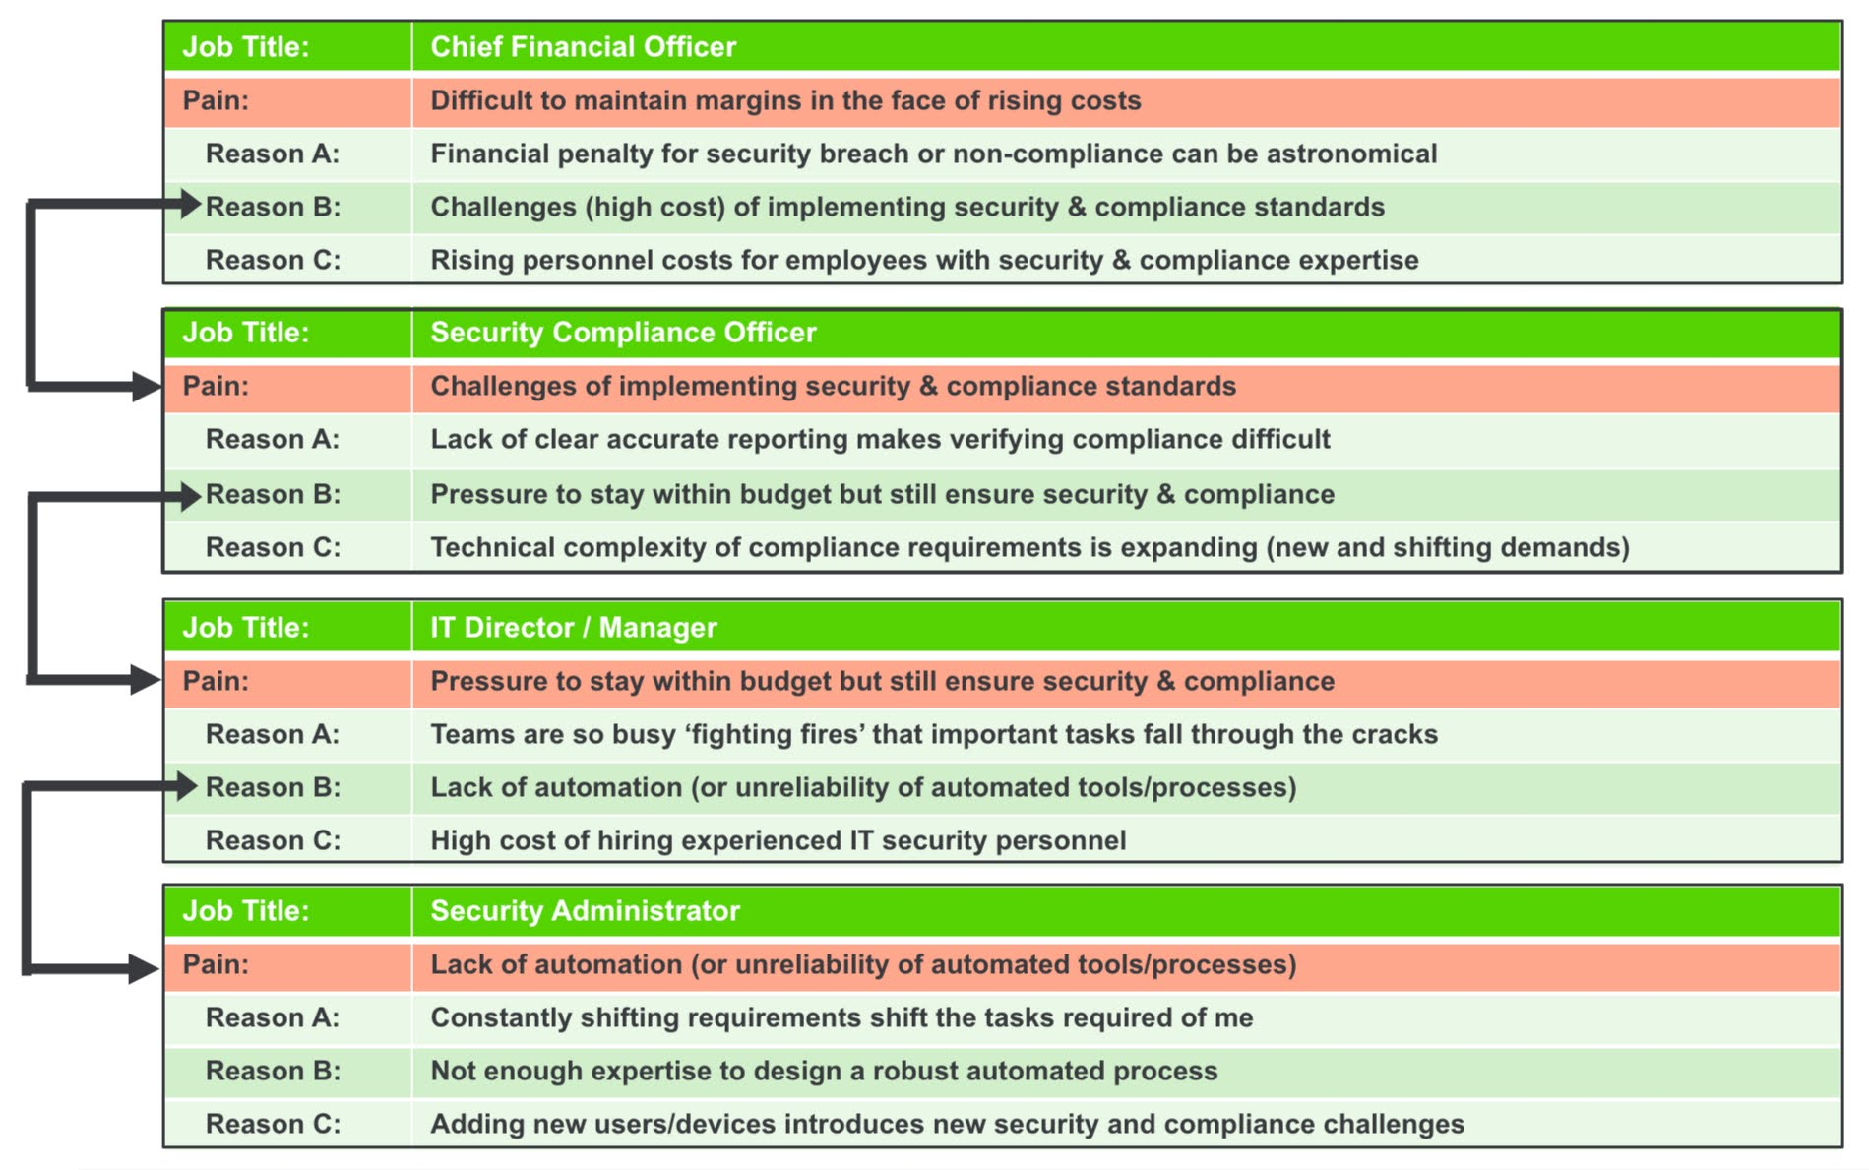
ADDITIONAL RESOURCES
Notes:
To help illustrate the interactions of different people in a B2B sale here is a slide one of my colleagues shared with me recently. CLICK
As you can see there are multiple different members of the “committee” that will make the recommendation. This is described as “The Chain of Pain” and shows how the group’s members and their associated goals interact. It is an example of how different members of a group or committee are connected.

Slide 45

Over to you!

Slide 46
QUESTIONS FROM DISCUSSION BOARDS & IN-BOX
What is A/B testing?
A/B testing, also known as split testing, refers to a randomized experimentation process wherein two or more versions of a variable (web page, page element, etc.) are shown to different segments of website visitors at the same time to determine which version leaves the maximum impact and drive business metrics.
A/B testing examples:
Media & Publishing Industry
eCommerce Industry
Travel Industry
Notes:
What is A/B testing?
A/B testing, also known as split testing, refers to a randomized experimentation process wherein two or more versions of a variable (web page, page element, etc.) are shown to different segments of website visitors at the same time to determine which version leaves the maximum impact and drive business metrics.
A/B testing examples:
Media & Publishing Industry
eCommerce Industry
Travel Industry
Continued at: https://vwo.com/ab-testing/

